Slide 1

Lecture
on
“Advanced Computer Architecture –TCS 704”
by
Akansha Gupta
DEPARTMENT OF COMPUTER SCIENCE AND ENGINEERING
GRAPHIC ERA DEEMED TO BE UNIVERSITY – 248002

Slide 2
State diagram

Slide 3
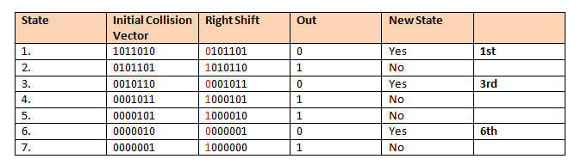
State Diagram
0 – New State Occur
1 – No New State Occur

Slide 4
From the state diagram we conclude that state 1,3 & 6 move to new state.
Next step is to find out the collision free state by applying OR operation with the initial collision vector of individual state.
Finally we will make the complete state diagram.

Slide 5
For State 1:
Initial State : 1011010
Shifted value from table: (OR) 0101101
-------------
1111111
This is the next state

Slide 6
For State 3:
Initial State: 1011010
Shifted value from table: (OR) 0001011
-----------
1011011
This the new State

Slide 7
For State 6:
Initial State: 1011010
Shifted value from table: (OR) 0000001
----------
1011011
This the new State

Slide 8
For the new states obtained above we will again find out the new collision free states by applying right shift and OR operation as we have done earlier.
Finally we will get the collision free states.
So we shall make the State Diagram for the same.

Slide 9
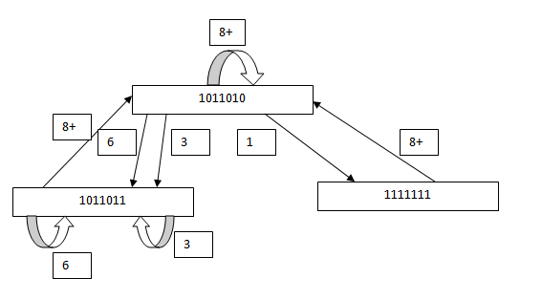
State Diagram

Slide 10
Simple cycle Average Latency
(Cycle visited only once)
(1,8) 1+8/2=4.5
8 8/1=8
6 6/1=6
3 3/1=3
(3,8) 3+8/2=5.5
(6,8) 6+8/2=7

Slide 11
Cycle with minimum edge is (1,8) & Avg. is 4.5
Value less than 4.5 in Avg. Latency is 3.
Therefore Greedy Cycles are (1,8) & 3.
MAL(Minimum Average Latency) is the minimum of the Average of greedy cycle =3
Throughput = 1/MAL
= 1/3
=0.33

Slide 12
https://youtu.be/nAq0LEdTMa8
thanks

